Slide 1

Profile of 'LEMB' & 'EMB' ETF
By Clayton DeBrower, Alan Chen, Max Stevens, and Eugene Caporale

Slide 2
LEMB (iShares J.P. Morgan EM Local Currency Bond ETF) Overview and Strategy
Overview
Current Price: $39.98
Total Net Assets (mil): $546.1
Shares Outstanding (mil): 13.8
Bid-Ask Spread: 0.01
Premium: 0.68%
LTM Total Return (dividends reinvested): -8.82%
Strategy
LEMB tracks a market-value weighted index of sovereign debt denominated in issuers' local currencies.
Provides access to the local-currency emerging-market sovereign debt space.
Targets investment-grade, fixed-rate, bullet-maturity emerging market sovereign bonds denominated in local currencies. Remaining maturity of generally six months or greater.

Slide 3
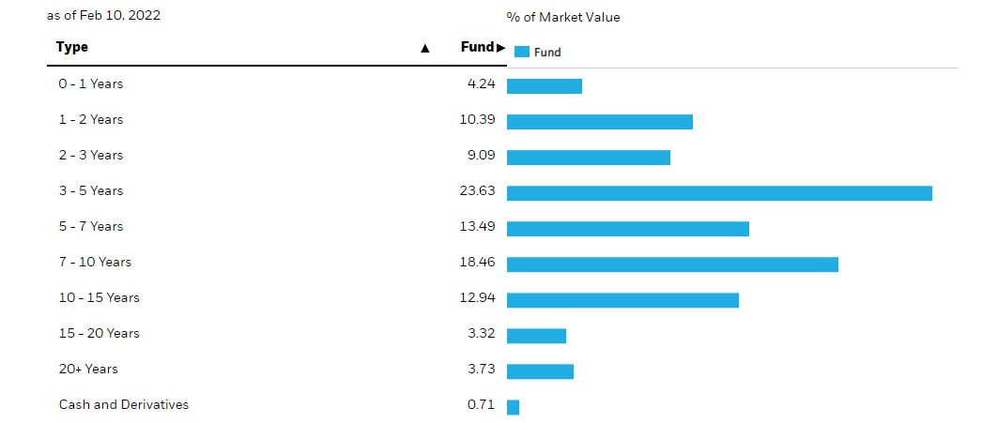
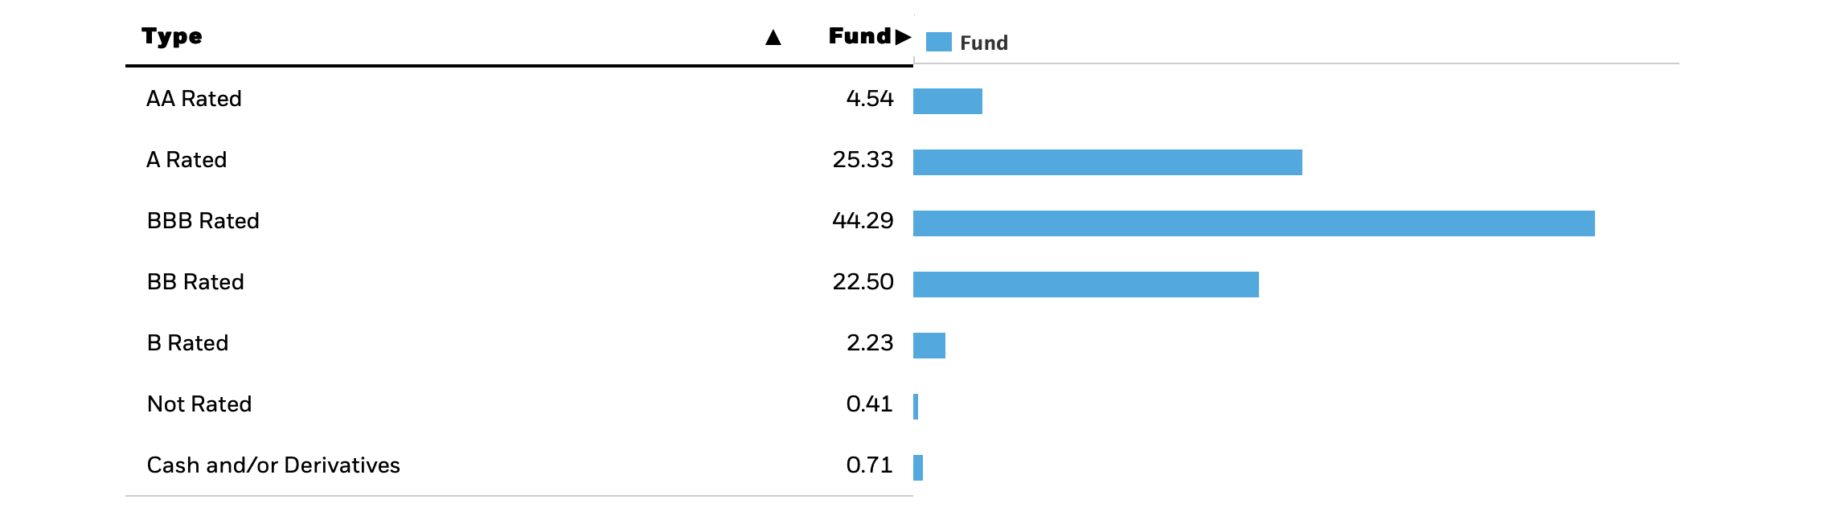
LEMB-Holdings
LEMB Holdings: 293 securities
Avg Credit Quality: BBB (Morningstar)

Slide 4
LEMB-Key Portfolio Metrics
Effective Duration: 5.01 years
Weighted Average Maturity (WAM): 6.93 years
Weighted Average Coupon (WAC): 5.64%
Weighted Average Yield: 6.46%
30-Day Average Daily Trading Volume: 185,389
Expense Ratio: 3 bps
Yield:
SEC 30Day: 5.77%
12Month Trailing: 3.89%
2y Weekly Beta
S&P500: 0.406
UST 10Y (CUSIP: 9128284V9): 0.306

Slide 5
LEMB-Advantages and Concerns
Favorable Characteristics
Gives the ability to diversify away from only US dollar-denominated emerging bonds
Credit Rating of BBB, which indicates it is investment grade (still good amount of credit risk)
Has a high Yield at 5.77% (SEC 30Day) and very low expense ratio (3 bps)
Unfavorable Characteristics
Over the last year, the ETF has lost about 10% of its value
Many of the ETF's holdings are in offshore exchanges and treasuries. This may cause additional tax considerations
The high duration presented with the ETF (5.08 years), which will lead to higher interest rate risk

Slide 6
EMB (iShares J.P. Morgan USD Emerging Markets Bond ETF)-Overview & Strategy
Overview:
Current Price: $103.50
Total Net Assets (mil): $18,450
Shares Outstanding (mil): 176
Bid-Ask Spread: 0.01
Premium: 0.41%
LTM Total Return (dividends reinvested): -3.90%
Strategy
EMB tracks the investment results of an index that is composed of US dollar-denominated, emerging market bonds
The bonds in the index are worth more than $1B outstanding and at least two years remaining in maturity
Access to the sovereign debt of 30+ emerging market countries in a single fund

Slide 7
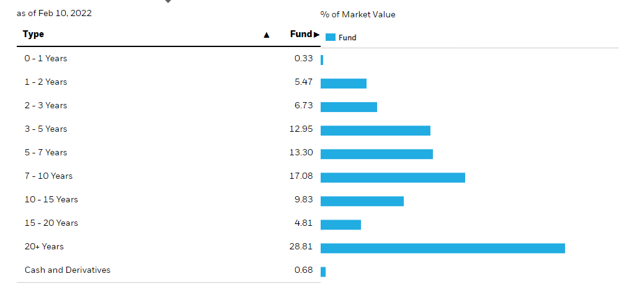
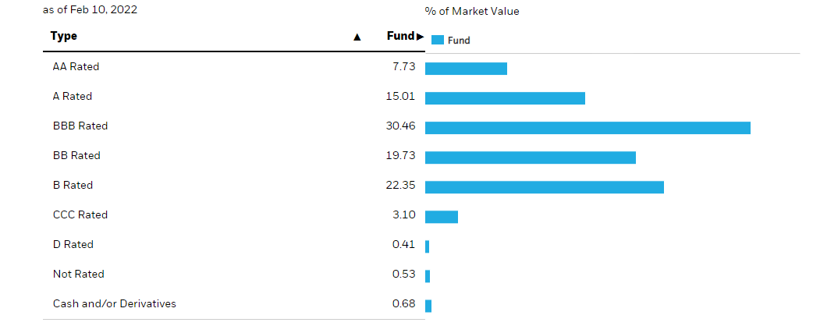
EMB-Holdings
EMB Holdings: 619 securities
Avg Credit Quality: BB (Morningstar)

Slide 8
EMB-Key Portfolio Metrics
Effective Duration: 8.21 years
Weighted Average Maturity (WAM): 13.25 years
Weighted Average Coupon (WAC): 4.81%
Weighted Average Yield: 5.08%
30-Day Average Daily Trading Volume: 8.07 million
Expense Ratio: 3.9 bps
Yield:
SEC 30Day: 4.48%
12Month Trailing: 4.05%
2y Weekly Beta
S&P500: 0.458
UST 10Y (CUSIP: 9128284V9): 0.538

Slide 9
EMB-Advantages and Concerns
Favorable Characteristics
Low expense ratio (3.9 bps), and high yield (4.48%-SEC 30Day)
Has a history of positive returns over the past 5 years
Very liquid. Roughly 5% of shares are traded daily
Unfavorable Attributes
The ETF has a credit rating of BB, which means it isn't an investment grade ETF
The duration of the ETF is 8.21. This is high and indicates a high susceptibility to interest rate risk.
No international exposure since the index is for US emerging markets

